Slide 1
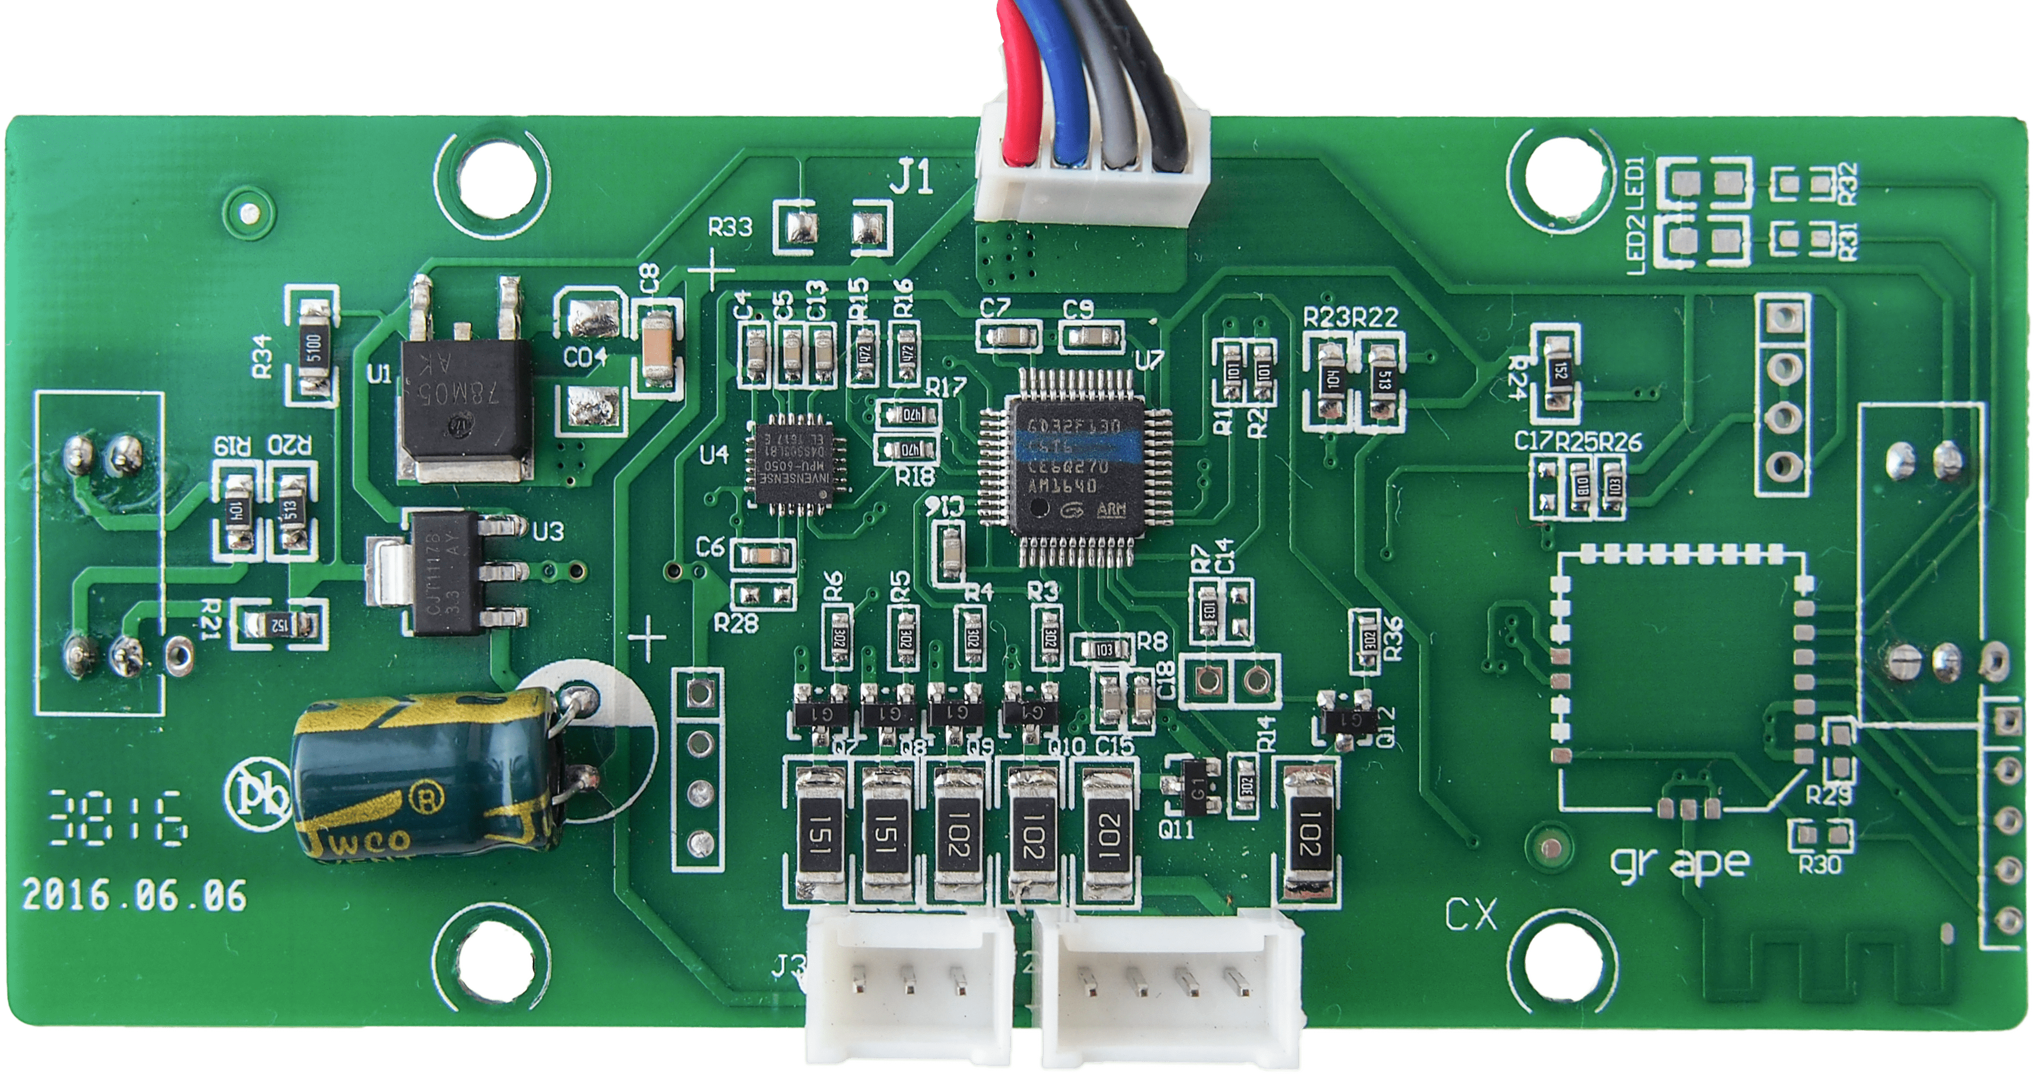
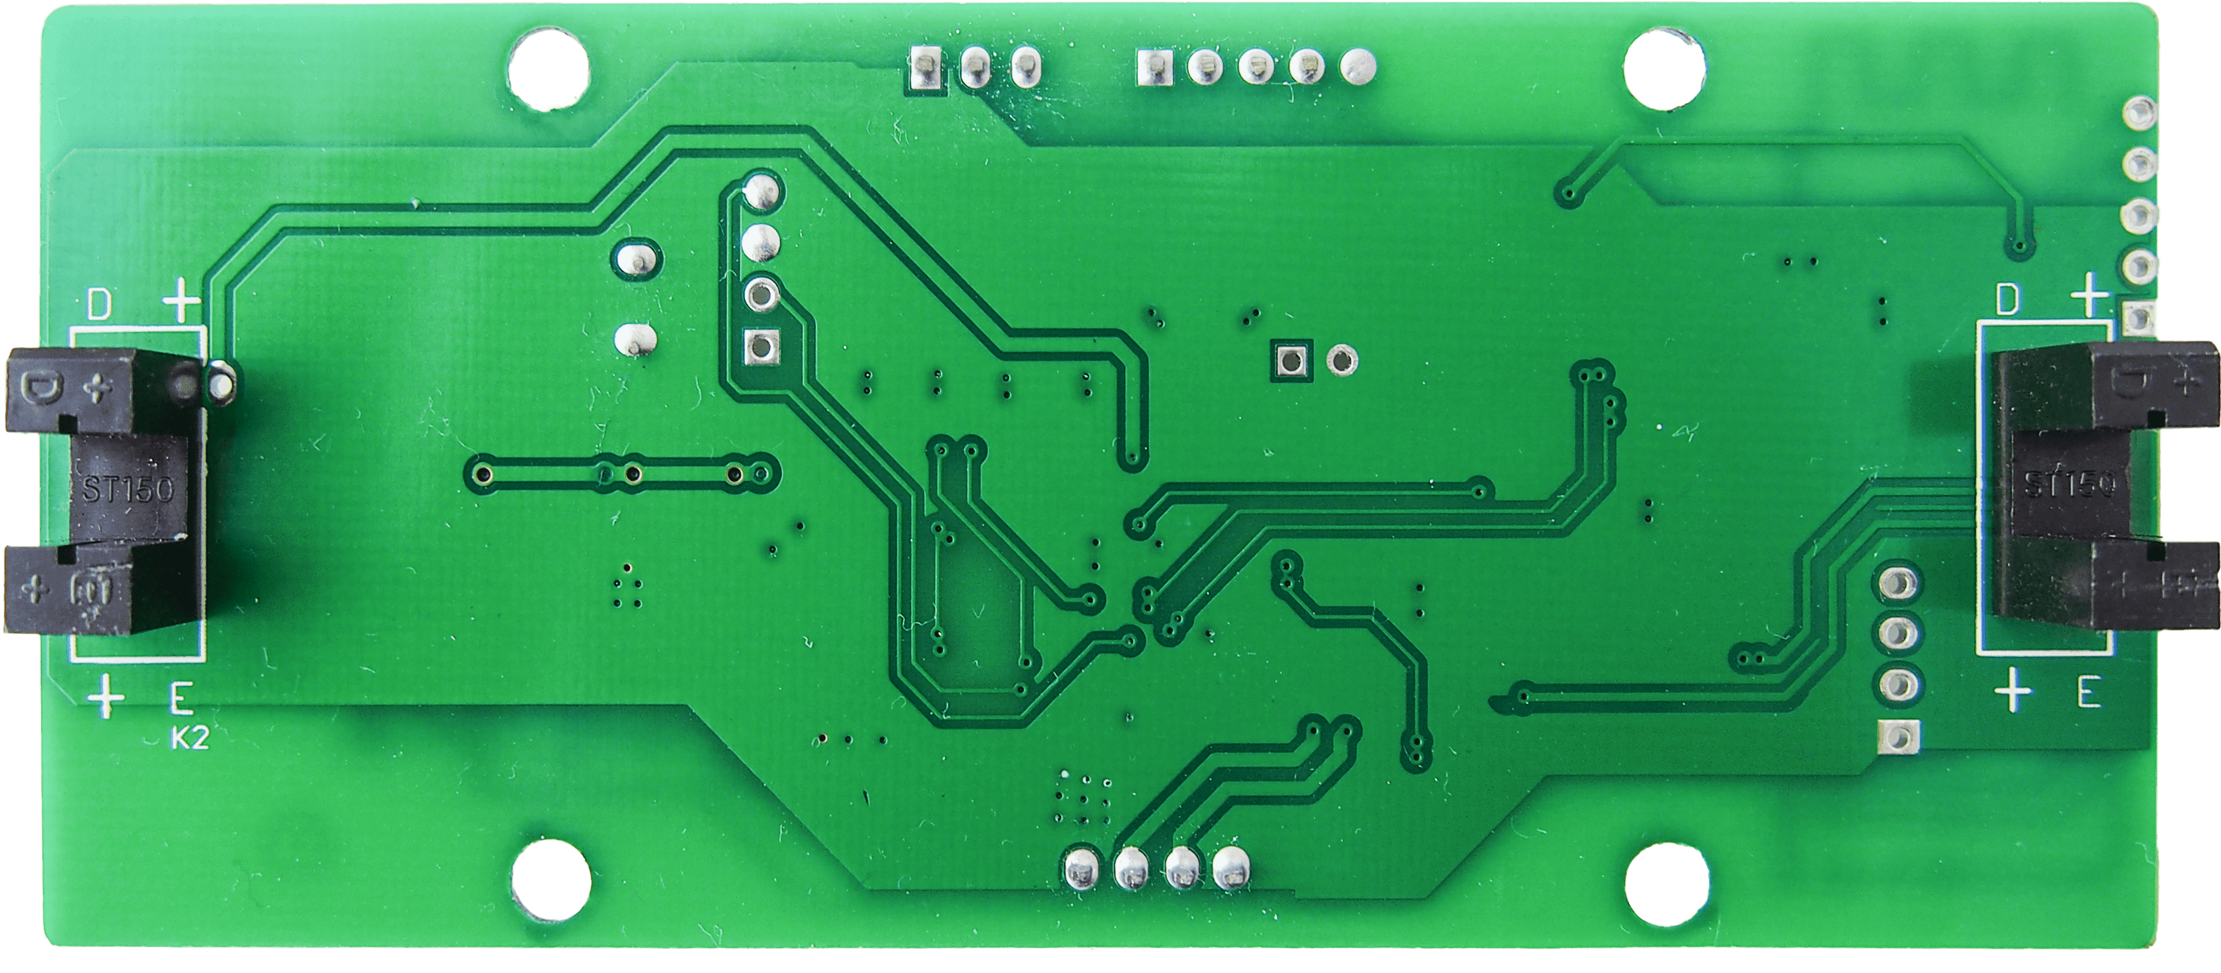
IMU MPU-6050
Main Board
PB6 / MPU_SCL
GND
PA2 / TX
PA3 / RX
PB7 / MPU_SDA
VDD 15V
PC14 / SENSOR2
SWD Programming
VDD 3.3V
PA14 / SWCLK
GND
PA13 / SWDIO
LED Boards
PB10 / AUX3
PA0 / LED1
PB9 / LED2
PB8 / LED3
PB5 / LED4
VDD 15V
PB4 / LED5
VDD 15V

Slide 2
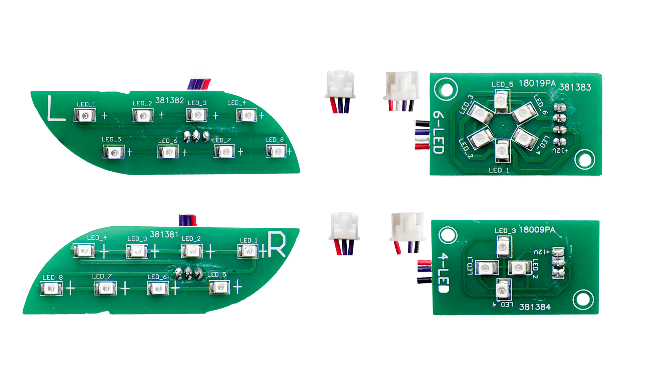

Slide 3
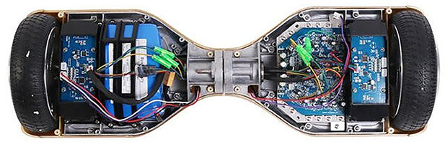
Mainboard
Pin Li-ion 10s2p
Khung xe
Động cơ không chổi than
Sideboard

